Slide 1
Week 4
Assignment：Center Selection
Name：张颜兵
Id：12132428
Department：MAE
SuperVisor：Prof.吴雷
Research Topic：Engineering calculation

Slide 2




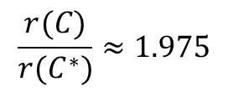
E1
$$Optimal$$
$$Greedy$$
$$r(C^{∗})=7.61$$
$r(C)=15.03，$first point is 22
$$\frac{r(C)}{r(C^{∗})}≈1.975$$

Slide 3
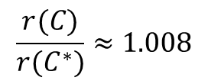




E1
$$Optimal$$
$$Greedy$$
$$r(C^{∗})=11.31$$
$r(C)=11.40，$first point is 7
$$\frac{r(C)}{r(C^{∗})}≈1.008$$

Slide 4
E2
Select the site with the highest site density as the initial point.

